Slide 1
Ch07_Deadlock and Indefinite Postponement

Slide 2
Contents
01_Introduction
02_Examples of Deadlock
03_Related Problem : Indefinite Postponement
04_Resource Concepts
05_Four Necessary Conditions for Deadlock
06_Deadlock Solutions
07_Deadlock Prevention
08_Deadlock Avoidance with Dijkstra’s Bankers Algorithm
09_Deadlock Detection
10_Deadlock Recovery
11_Deadlock Strategies in Current and Future Systems

Slide 3
01_Introduction
Deadlock
A state that a process or thread is waiting for a particular event that will not occur
Starvation (= Indefinite Postponement)
A process that is not deadlocked but wait for an event that might never occur or might occur unpredictably far in the future
The four major areas of deadlock research
Deadlock Prevention
Deadlock Avoidance
Deadlock Detection
Deadlock Recovery

Slide 4
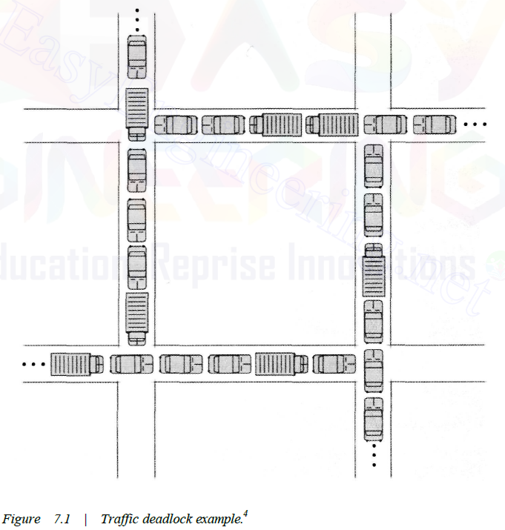
02_Examples of Deadlock (1/3)
Traffic Deadlock

Slide 5
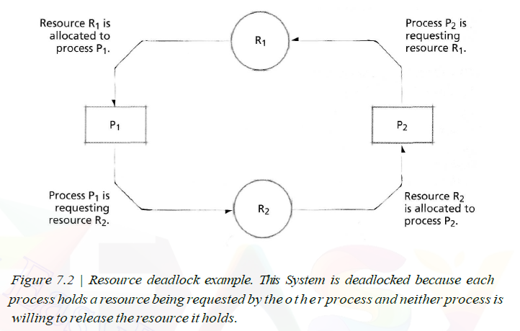
02_Examples of Deadlock (2/3)
Simple Resource Deadlock
Most deadlocks in operating systems develop because of the normal contention for dedicated resources
Circular wait is characteristic of deadlocked systems

Slide 6
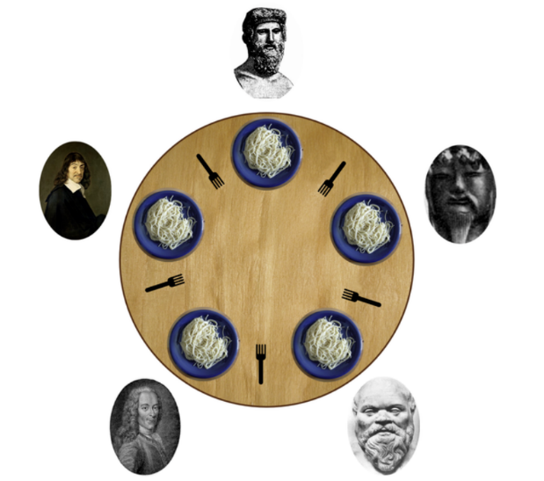
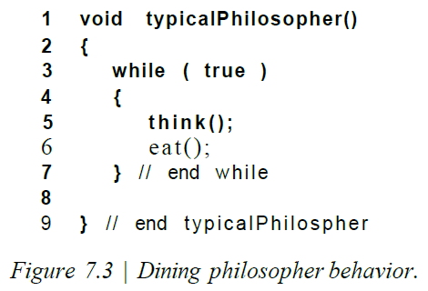
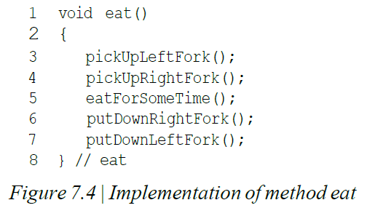
02_Examples of Deadlock (3/3)
Spooling File
Deadlock in Spooling Systems
Spooling systems can be subject to deadlock
Common solution
Restrain the input spoolers so that they do not accept additional print jobs when the spooling files begin to reach some saturation threshold
Reduce system throughput
Today's systems
Allow printing to begin before the job is completed so that a full, or nearly full, spooling file can begin emptying while a job is still executing
In many systems spooling space allocation has been made more dynamic, so that if existing space starts to fill, then more space may be made available
Another Example: Dining Philosophers
Spooling
Remained
Space
Spooled Files
Saturation
Threshold
Spooling & Printing
Dynamic Space Allocation

Slide 7
03_Related Problem : Indefinite Postponement
Indefinite postponement
A process may be delayed indefinitely while other processes receive the system's attention (= Indefinite blocking, = starvation)
Occur because of biases in a system's resource scheduling policies
Aging (Prevention of Indefinite Postponement)
By increasing a process's priority gradually as it waits for a resource

Slide 8
04_Resource Concepts
Resources that are preemptible
Processors and main memory
Processors must be rapidly switched among all active processes competing for system service to ensure that these processes progress at a reasonable rates
Resources that are nonpreemptible
Tape drives and optical scanners
Cannot be removed from the processes to which they are assigned until the processes voluntarily release them
Reentrant code
The code is not modified as it executes
Shared by several processes simultaneously
Serially reusable code
Code that may be changed but is reinitialized each time it is used
Used correctly by only one process at a time

Slide 9
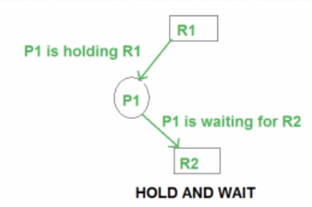
05_Four Necessary Conditions for Deadlock
Mutual exclusion condition
A resource is acquired exclusively by only one process at a time
Wait-for condition (=the hold-and-wait condition)
A process that has acquired an exclusive resource may hold that resource while the process waits to obtain other resources

Slide 10
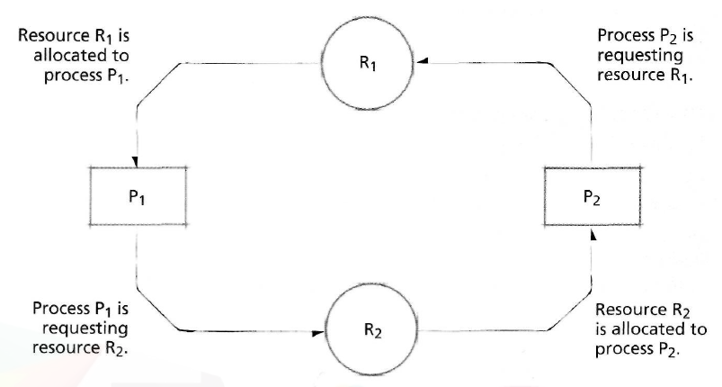
05_Four Necessary Conditions for Deadlock
Nopreemption condition
Once a process has obtained a resource, the system cannot remove it from the process's control until the process has finished using the resource
Circular-wait condition
Two or more processes are locked in a "circular chain"
Each process is waiting for one or more resources that the next process in the chain is holding

Slide 11
06_Deadlock Solutions
Deadlock prevention
Remove any possibility of deadlocks occurring
Deadlock avoidance
Allow the possibility to loom, but whenever a deadlock is approached, it is carefully sidestepped
Deadlock detection
Determine if a deadlock has occurred, and identify the processes and resources that are involved
Deadlock recovery
Clear deadlocks from a system so that the deadlocked processes may complete their execution and free their resources

Slide 12
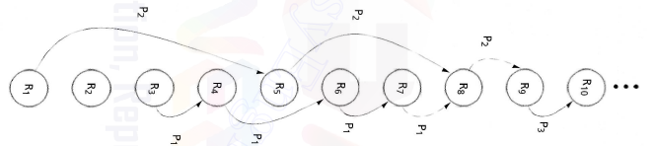
07_Deadlock Prevention
Deadlock prevention
Denying the "Wait-For" Condition
All of the resources a process needs to complete its task must be requested at once
Disadvantage - Wastes resources
Denying the "No-Preemption" Condition
When a process holding resources, it is denied a request for additional resources, it must release the resources it holds and, if necessary, request them again together with the additional resources
Disadvantage - When a process releases resources, it may lose all of its work to that point
Denying the "Circular-Wait" Condition
A process request its resources in a strictly ascending order
Disadvantage - It is not as flexible or dynamic as we might desire because it is hard to determine the ordering of resources in a system

Slide 13
08_Deadlock Avoidance with Dijkstra’s Bankers Algorithm (1/6)
Banker's Algorithm
Modeled after a banker who makes loans from a pool of capital and receives payments that are returned to that pool
Defines how a particular system can prevent deadlock by carefully controlling how resources are distributed to users
A system groups all the resources it manages into resource type
Safe state
The operating system guarantees that all current processes can complete their work within a finite time
Unsafe state
System is not in deadlock state but can not guarantee that all current processes can complete their work within a finite time

Slide 14
08_Deadlock Avoidance with Dijkstra’s Bankers Algorithm (2/6)
Banker's Algorithm – Properties
The operating system shares a fixed number of resources, t, among a fixed number of processes, n
Each process has to specify in advance the maximum number of resources
The process cannot request more than the total number of resources available in the system
The operating system guarantees a finite wait time to the process
The process guarantees that the resource will be used and released to the operating system within a finite time

Slide 15
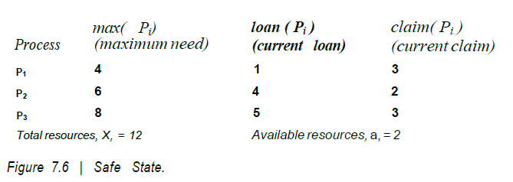

08_Deadlock Avoidance with Dijkstra’s Bankers Algorithm (3/6)
Banker's Algorithm
Example of a Safe State

Slide 16

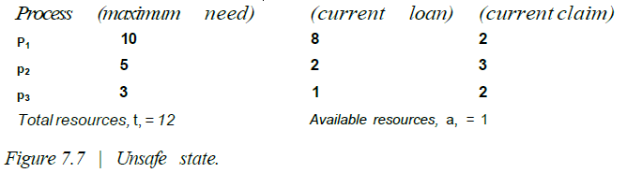
08_Deadlock Avoidance with Dijkstra’s Bankers Algorithm (4/6)
Banker's Algorithm
Example of an Unsafe State

Slide 17
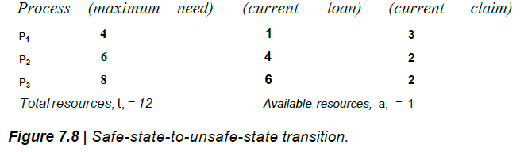
08_Deadlock Avoidance with Dijkstra’s Bankers Algorithm (5/6)
Banker's Algorithm
Example of Safe-State-to-Unsafe-State Transition
The current value of a is 2
Process P3 requests an additional resource
Assigned 1

Slide 18
08_Deadlock Avoidance with Dijkstra’s Bankers Algorithm (6/6)
Banker's Algorithm – Weaknesses
Requiring a fixed number of resources → cannot guarantee the number of resources remaining fixed(resources can be out of order)
Requiring a fixed number of processes → the process population is constantly changing
Requires that the system grant all requests within a “finite time” → hard to achieve
Requires that processes return all resources within a “finite time”
→ hard to achieve
Requires that processes specify their maximum needs in advance
→ difficult to know a process’s maximum needs
Only a few systems can afford the overhead incurred by deadlock avoidance strategies

Slide 19
09_Deadlock Detection (1/4)
Determining that a deadlock exists
Identifying the processes and resources involved in the deadlock
Focus on determining if a circular wait exists
Incur significant runtime overhead
Trade-off
Overhead for deadlock detection
vs.
Savings from locating and breaking up deadlocks

Slide 20
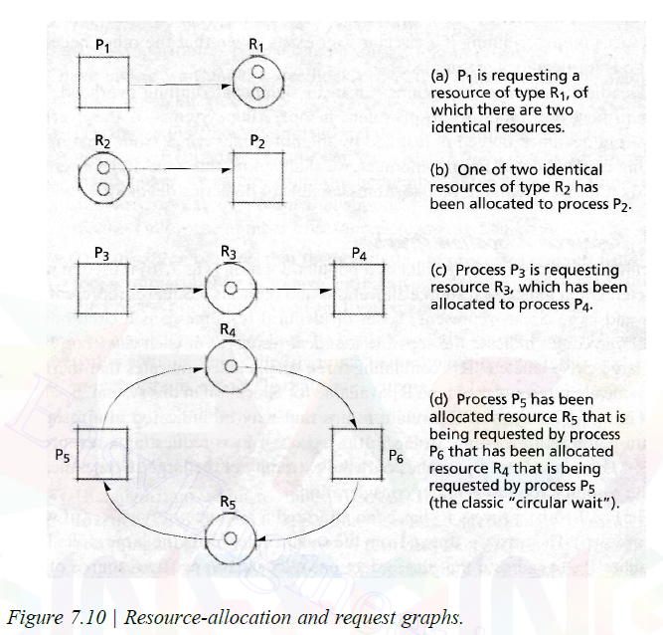
09_Deadlock Detection (2/4)
Resource-Allocation Graphs
Square : Process
Large circle : classes of identical resources
Small circle : the separate identical resources of each class

Slide 21
09_Deadlock Detection (3/4)
Reduction of Resource-Allocation Graphs
Detecting
the processes that may complete their execution
the processes that will remain deadlocked
If a process's resource requests may be granted, then we say that a graph may be reduced by that process.
If a graph can be reduced by all its processes, then there is no deadlock

Slide 22
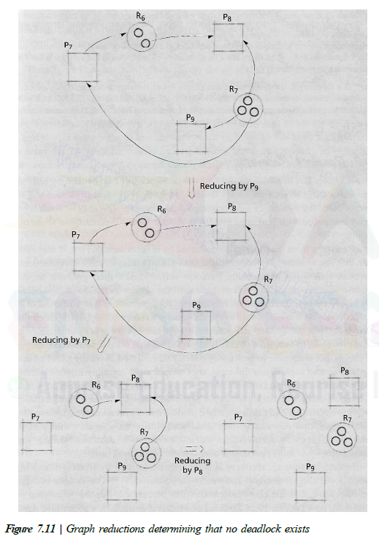
09_Deadlock Detection (4/4)
Reduction of Resource-Allocation Graphs

Slide 23
10_Deadlock Recovery (1/2)
Once a system has become deadlocked
The deadlock must be broken by removing one or more of the four necessary conditions
Some processes will lose some or all of the work they have accomplished
a small price to pay compared with leaving a system in a state where it cannot use some of its resources
Recovery from deadlock is complicated
It may not be clear that the system has become deadlocked
No means to remove the deadlocked process from the system and resume it without any loss of work
The deadlock could involve many processes (tens, or even hundreds)

Slide 24
10_Deadlock Recovery (2/2)
Recovery from deadlock
Forcibly removing a process from the system and returning its resources
Suspend/resume mechanism
Allows the system to put a temporary hold on a process and, when it is safe to do so, to resume the held process without loss of work
Checkpoint/rollback – Database System
Manages with system failures and deadlocks by attempting to preserve as much data as possible from each terminated process
Last Checkpoint - saved state of the system
Rollback - undoing every operation related to the terminated process that occurred since the last checkpoint

Slide 25
11_Deadlock Strategies in Current and Future Systems
Deadlock importance relies on the Operating System type
In personal computer systems and workstations, deadlock has generally been viewed as a limited annoyance
Far more important to prevent deadlock in mission-critical or business-critical system
Deadlock is an important area of research
Many large-scale systems are oriented more toward asynchronous parallel operations than toward the serial operations
The number of resources that operating systems must manage is increasing dramatically since data is considered as a resource
Systems have limited resources but are requiring the large demands of real-time tasks

